Slide 1
STUDENT HUB

Slide 2


Slide 3

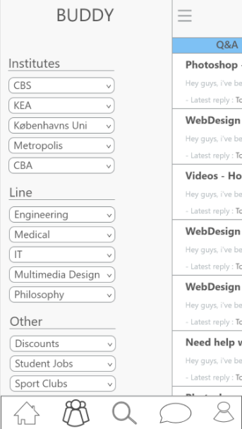
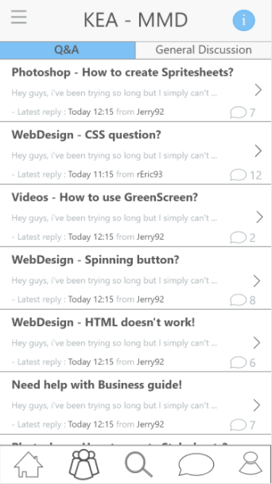
Customer journeys / Prototypes

Slide 4
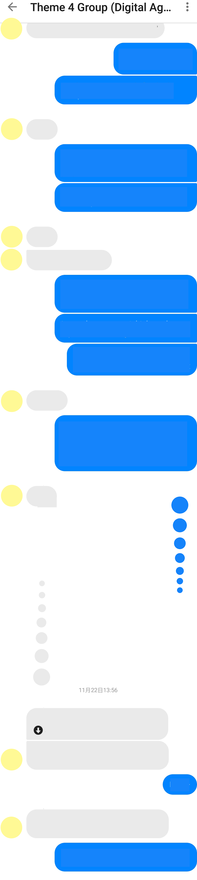
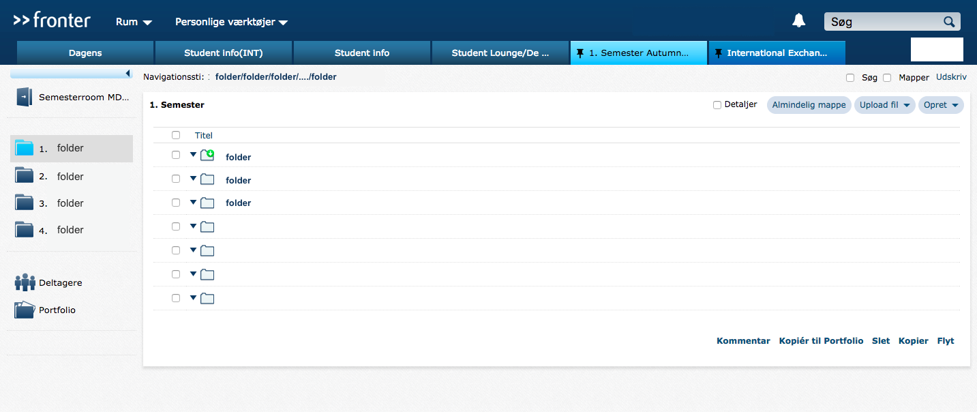
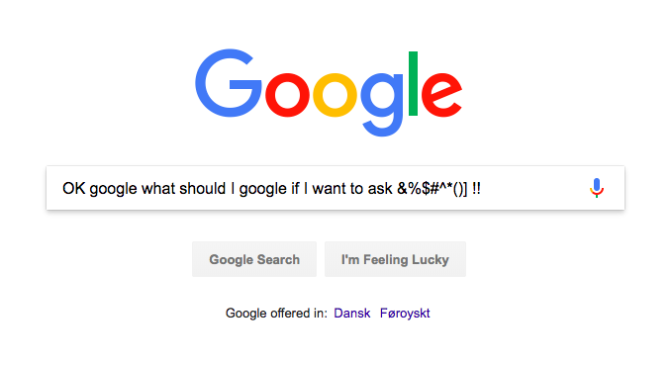



countless lines to follow

Slide 5
DAY & NIGHT
When you read something helpful or important, just highlight this part and the content will be kept in your Notes on Student Hub. A lot more to read blahblahblahhh ..
When you read something helpful or important, just highlight this part and the content will be kept in your Notes on Student Hub. A lot more to read blahblahblahhh ..

Slide 6

the reservoir & the ever refreshing source of everything that students need
shared by students, for students
constant improving
by: Kasper L. Jensen
Lars Ljungdahl
Linda Vorobeja
Weronika Wdowiak
Yan Li

